Slide 1





MAJOR PROJECT-2
GAS AND SMOKE DETECTION TO
PREVENT FIRE ACCIDENTS WITH GSM ALERT SYSTEM
8th Semester
2018 Admitted Batch
ELECTRICAL AND ELECTRONICS ENGINEERING
School of Electronics Engineering
Kalinga Institute of Industrial Technology, Deemed to be
University Bhubaneswar, India 2022
GROUP MEMBERS
1807258 | Ashish
1807259 | Ashutosh Yadav
1807265 | B.Dheeraj Chandan
1807266 | Biswayan Banerjee
1807292 | P. Sai Manohar

Slide 2




Contents
01
Group Members
02
Introduction
03
Components & Software
04
Working & Coding
05
Conclusion

Slide 3


Under the guidance of :
Prof. R.K Khanna
1807258 | Ashish
1807259 | Ashutosh Yadav
1807265 | B.Dheeraj Chandan
1807266 | Biswayan Banerjee
1807292 | P. Sai Manohar

Slide 4
02
Introduction
GAS AND SMOKE DETECTION TO
PREVENT FIRE ACCIDENTS WITH GSM ALERT SYSTEM
Nowadays, securing one's property and business against fire is becoming more and more important.
Monitoring commercial and residential areas all-round is an effective method to reduce personal and property losses due to fire disaster.
Home fire detection is a matter of great concern, and thus many efforts are devoted in most developed countries to the design of automatic detection systems, A alarm system should reliably and in a
timely way notify building occupants about the presence of fire indicators, such as smoke or high
temperatures. A fire detector is usually implemented as a smoke sensor due to its early fire detection capability, fast response time and relatively low cost. Other options for the fire detection are based
on gas sensors

Slide 5
The main purpose of this project is to design and implement an automatic fire and smoke detection and prevention system that can be produced at a low cost with effective and competitive usage. This System is designed to be more users friendly and easy to operate at any level.
The project is also been designed to be further working vision using minimum hardware at the lower
level of processing.
Our objective is to design a gas and smoke detection and alerting system that would fulfill the
following:
To prevent gas and smoke.
To sound the alarm if gas and smoke occurs.
To indicate the state of the room as ‘Safe’ in order to avoid any confusion under normal
condition. So the system should never be in any ambiguous state.

Slide 6
INTRODUCTION ABOUT SMOKE AND GAS SENSORS
Smoke or gas detectors, a relatively newer invention, became widespread during 1970’s and 1980s.
These detectors usually detect fire in early flaming or smoldering stages.
These detectors can be of different types having different operation principles
namely optical or photoelectric detectors, ionization detectors, air sampling detectors etc.
smoke detectors include various components, mainly, a light source (usually an infrared LED), and a lens to converge light rays into a beam, and a photodiode.
In normal condition, the light beam passes straight.
But whenever smoke interrupts the path of light, scatters fraction of light into the photo diode, the smoke detector is activated.

Slide 7
Gas sensors (also known as gas detectors) are electronic devices that detect and identify different types of gasses.
They are commonly used to detect toxic or explosive gasses and measure gas
concentration. Gas sensors are employed in factories and manufacturing facilities to
identify gas leaks, and to detect smoke and carbon monoxide in homes.
Gas sensors vary widely in size (portable and fixed), range, and sensing ability.
They are often part of a larger embedded system, such as hazmat and security
systems, and they are normally connected to an audible alarm or interface.
Because gas sensors are constantly interacting with air and other gasses, they have to be calibrated more often than many other types of sensors.
A gas sensor is a device which detects the presence or concentration of gases in the atmosphere. Based on the concentration of the gas the sensor produces a corresponding potential difference by changing the resistance of the material inside the sensor, which can be measured as output voltage.

Slide 8
Types of Gas sensors
MEMS Pellistors.
Infrared Gas Sensors.
Catalytic Pellistors.
Thermal Conductivity Gas Sensors.
Metal Oxide Gas Sensors.
Electrochemical Gas Sensors.
Evaluation Kits.
Indoor Air Quality sensors.

Slide 9
03
Components & Software Required for
operating :
Electronic components :
Arduino UNO R3 board
MQ-2 Gas Sensor
MQ-3 Smoke Sensor
LCD Screen 16x2
SIM 900D GSM MODULE
DC MOTOR
SERVO MOTOR
Buzzer Resistor
Software :
Arduino IDE
Proteus Design Suite

Slide 10
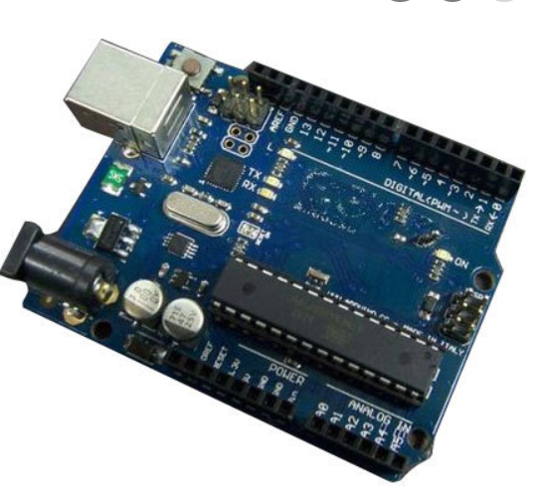
ARDUINO UNO R3
Arduino UNO is a microcontroller board based on the ATmega328P. It has 14 digital input/output pins (of which 6 can be used as PWM outputs), 6 analog inputs, a 16 MHz ceramic resonator, a USB connection, a power jack, an ICSP header and a reset button. It contains everything needed to support the microcontroller; simply connect it to a computer with a USB cable or power it with a AC-to-DC adapter or battery to get started.

Slide 11
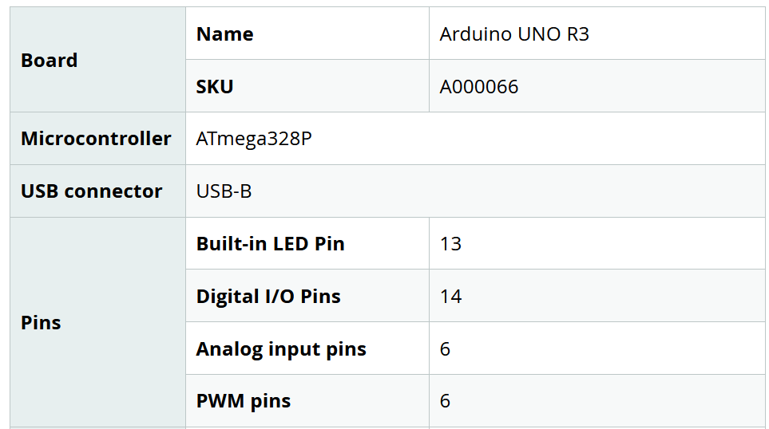
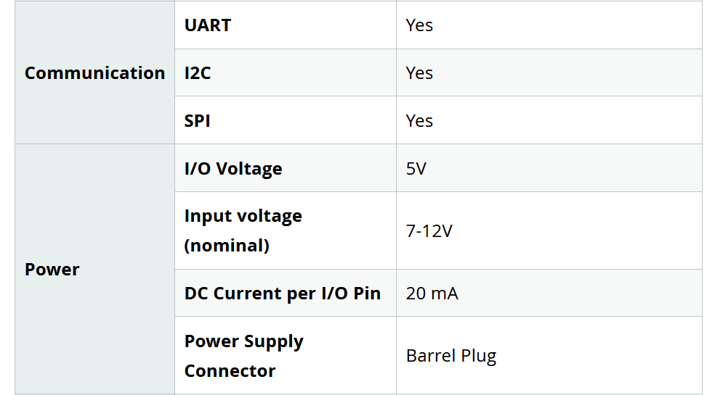
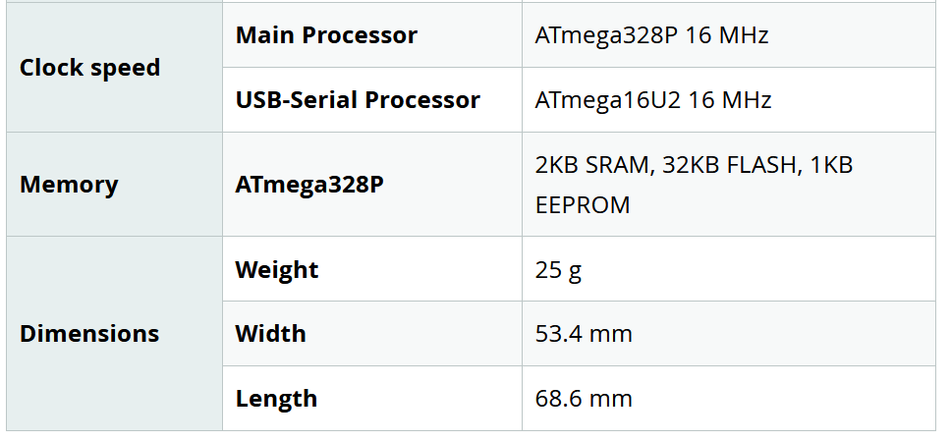

Slide 12
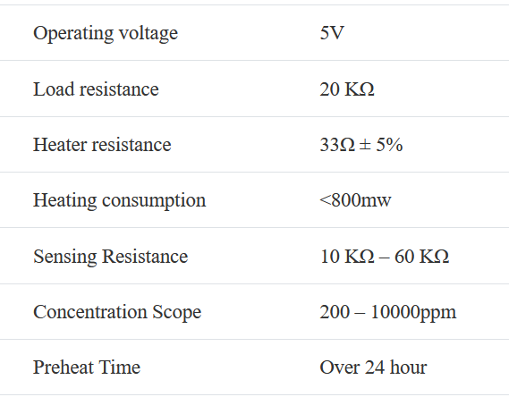
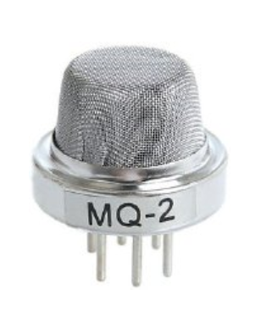
MQ-2 GAS SENSOR
MQ2 is one of the commonly used gas sensors in MQ sensor series.It is a Metal Oxide Semiconductor (MOS) type Gas Sensor also known as Chemiresistors as the detection is based upon change of resistance of the sensing material.
They are commonly used to detect toxic or explosive gasses and measure gas concentration. Gas sensors are employed in factories and manufacturing facilities to identify gas leaks, and to detect smoke and carbon monoxide in homes.

Slide 13
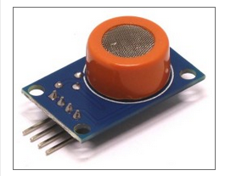
MQ-3 SMOKE SENSOR
MQ-3 sensor module is usefull module for detecting
alcohol or smoke concentration.
Operating voltage: 5V DC Features:
Microprocessor compatible TTL output.
High sensitivity.
It measures the alcohol concentration precisely.
It can also measure smoke and alcohol with low sensitivity.
Measurement Range: 0.04-4mg /
It has a long working life and stability.
Fast response time.
Plug and play convenience for testing with plugged probes.

Slide 14
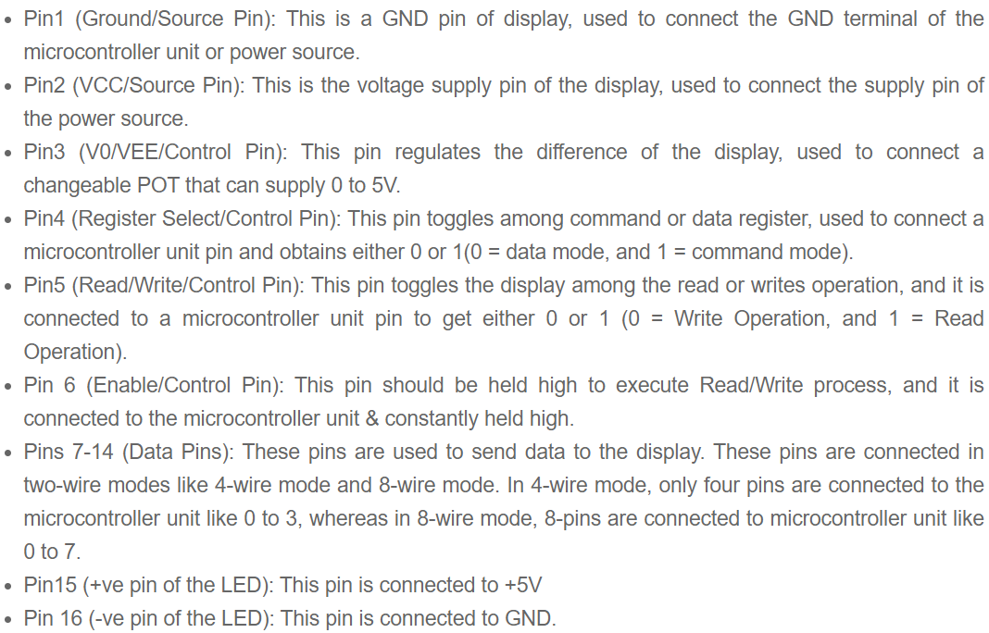
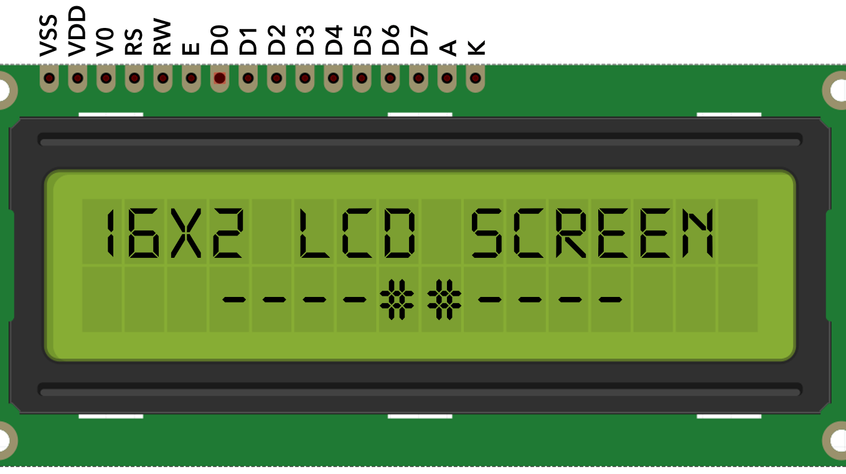
Screen LCD
LCD also known as Liquid-Crystal Display.
Its a 8 bit data bus representing 11 data lines).

Slide 15
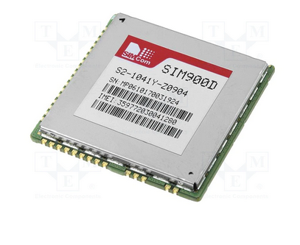
SIM 900D GSM MODULE
A customised Global System for Mobile communication (GSM) module is designed for wireless radiation monitoring through Short Messaging Service (SMS). This module is able to receive serial data from radiation monitoring devices such as survey meter or area monitor and transmit the data as text SMS to a host server.
Communications modules features :
A/D converter
antenna connector
AT commands controlled (GSM07.07, 07.05 and extended AT SIMCOM commands)
compatible with GSM phase 2/2+
GPRS mobile station class B
GPRS multi-slot class 10/8
integrated TCP/IP protocol
PWM output
RTC
supports of 1.8V and 3.3V SIM cards

Slide 16
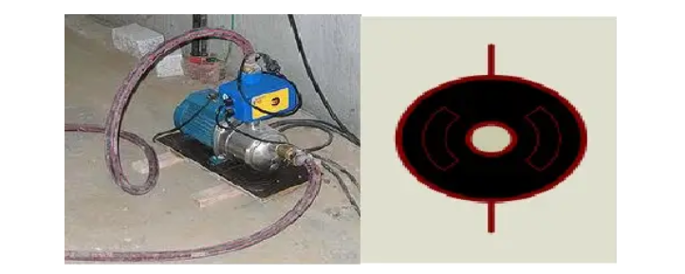
DC MOTOR
A simple DC motor uses a stationary set of magnets in the stator, and a coil of wire with a current running through it to generate an electromagnetic field aligned with the centre of the coil. One or more windings of insulated wire are wrapped around the core of the motor to concentrate the magnetic field.
DC motors have the advantage of higher starting torque, quick starting and stopping, reversing, variable speeds with voltage input and they are easier and cheaper to control than AC.
Main Types of DC Motors
Permanent Magnet DC Motors: The permanent magnet motor uses a permanent magnet to create field flux.
Series DC Motors:In a series DC motor, the field is wound with a few turns of a large wire carrying the full armature current.
Shunt DC Motors.
Compound DC Motors.

Slide 17
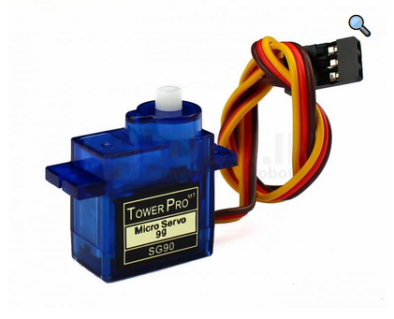
DC SERVO MOTOR
The DC servo motor definition is, a motor that is used in servo systems is known as a servo motor. A servo system is a closed-loop system
where the feedback signal (position, velocity, acceleration, etc.) drives
the motor. This signal acts as an error and based on controller, accurate position or velocity is achieved.
Servo motor works on PWM (Pulse width modulation) principle, means its angle of rotation is controlled by the duration of applied pulse to its Control PIN. Basically servo motor is made up of DC motor which is controlled by a variable resistor (potentiometer) and some gears.

Slide 18
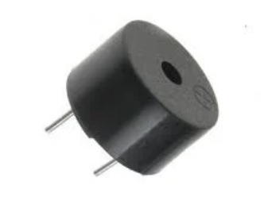
BUZZER
A buzzer or beeper is an audio signaling device, which may be mechanical, electromechanical, or piezoelectric (piezo for short). Typical uses of buzzers and beepers include alarm devices, timers, and confirmation of user input such as a mouse click or keystroke.
The buzzer is a sounding device that can convert audio signals into sound signals. It is usually powered by DC voltage. It is widely used in alarms, computers, printers and other electronic products as sound devices.12

Slide 19
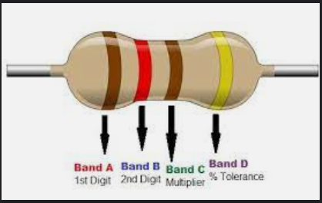
RESISTOR
A resistor is a passive two-terminal electrical component that implements electrical resistance as a circuit element. In electronic circuits, resistors are used to reduce current flow, adjust signal levels, to divide voltages, bias active elements, and terminate transmission lines, among other uses
A resistor controls the flow of the electrical current within a circuit. Resistors are made from materials like copper or carbon, which make it difficult for the electrical charges to flow through a circuit.

Slide 20

ARDUINO IDE
The Arduino integrated development (IDE) is an application that is
deployed across platforms like Windows, mac OS and UNIX
operating system, Java being the artificial language.
It is used to write and transfer programs to Arduino compatible boards.
The languages supported by the Arduino IDE primarily C and C++ ,
additionally to that special rules of code structuring i.e compatible.

Slide 21
PROTEOUS
Proteus is used to simulate, design and drawing of electronic circuits. It was invented by the Labcenter electronic. By using proteus you can make two-dimensional circuits designs as well.
The Proteus Design Suite is widely used across various industry sectors as a cost effective solution for professional PCB design and as a rapid prototyping tool for R&D.
Proteus is a complete development platform from product concept to design completion. Its advantages are intelligent principle layout, hybrid circuit simulation and accurate analysis, single-chip software debugging, single-chip and peripheral circuit co-simulation, PCB automatic layout and wiring.

Slide 22
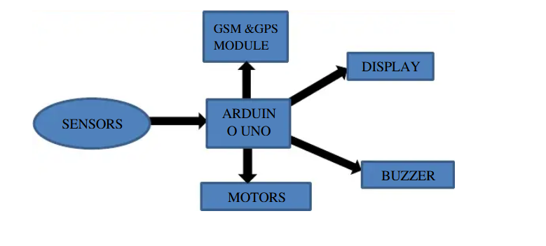
FLOW CHART

Slide 23
04
Working
In the project the main role goes to smoke sensor and gas sensor
first we connect all the main components like gas sensor and smoke sensor to arduino.
1.GAS SENSOR
we initialize sensor value to zeroand we assume if the value is above 50 then the gas is detected
It is a Metal Oxide Semiconductor (MOS) type Gas Sensor as the detection is based upon change of resistance of the sensing material when the Gas
comes in contact with the material. Using a simple voltage divider network, concentrations of gas can be detected.MQ2 Gas sensor works on 5V DC and draws around 800mW. It can detect LPG, Smoke, Alcohol, Propane, Hydrogen, Methane and Carbon Monoxide concentrations anywhere from 200 to 10000ppm("parts per million").

Slide 24
04
Working
This sensor contains a sensing element, mainly aluminium-oxide based ceramic, coated with Tin dioxide, enclosed in a stainless steel mesh. Sensing element has six connecting legs attached to it. Two leads are responsible for heating the sensing element, the other four are used for output signals.
Oxygen gets adsorbed on the surface of sensing material when it is heated in air at high temperature. Then donor electrons present in tin oxide are attracted towards this oxygen, thus preventing the current flow.
When reducing gases are present, these oxygen atoms react with the reducing gases thereby decreasing the surface density of the adsorbed oxygen. Now current can flow through the sensor, which generated analog voltage values.
These voltage values are measured to know the concentration of gas. Voltage values are higher when the concentration of gas is high.

Slide 25
04
Working
2.SMOKE SENSOR
If you're using a 5V Arduino, and connecting the sensor directly into an Analog pin, you can use these formulas to turn the 10-bit analog reading into a
temperature:
Voltage at pin in milliVolts = (reading from ADC) * (5000/1024)
This formula converts the number 0-1023 from the ADC into 0-5000mV (= 5V)
Then, to convert millivolts into temperature, use this formula:
Centigrade temperature = [(analog voltage in mV) - 500] / 10
we initialize sensor value to zero and we assume if the value is equal or above 100 then the smoke is detected

Slide 26
04
Working
Inside, the sensor holds the resistance across two points. On the disclosure of smoke, the sensor detects it and therefore this resistance varies. Higher the level of the smoke, the lower the resistance would be. And, the smaller the resistance of the sensor, the higher the voltage reading would be. Hence, the smoke is
tested by measuring this resistance. The sensor and load resistor together build a voltage divider.

Slide 27
04
Working
3. now we come to SIM900D GSM
To send an SMS, we should set our GSM module to Text mode first.
This is achieved by sending an AT Command “AT+CMGF=1”
After setting the GSM module to Text mode, we should the the mobile number to which we shall send the SMS. This is achieved with AT command
“AT+CMGS=”+91xxxxxxxxxx”” – where you may replace all x with the mobile
number.
The end of SMS content is identified with CTRL+Z symbol. The ASCII value of this CTRL+Z is 26. So we send a char(26) to GSM module using the line mySerial.println((char)26);

Slide 28
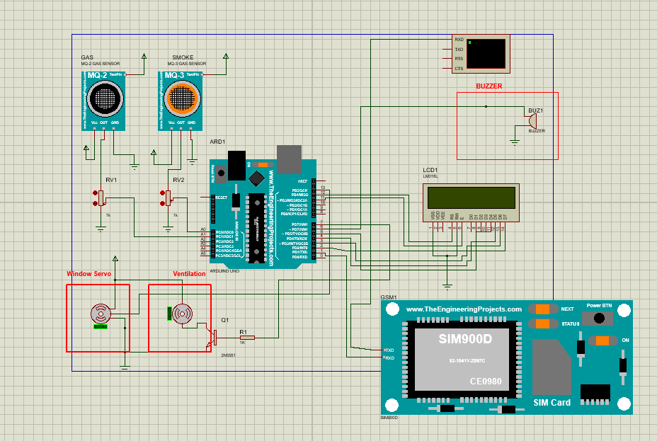
Setup

Slide 29
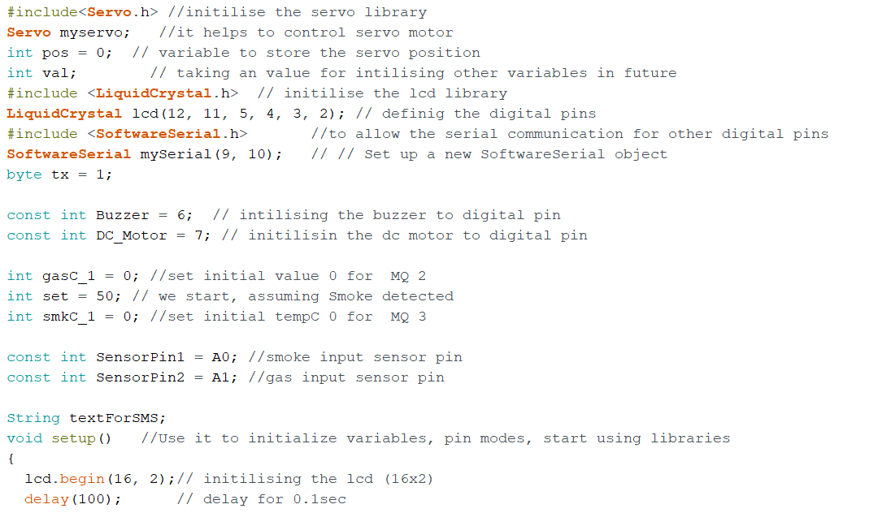
Coding

Slide 30
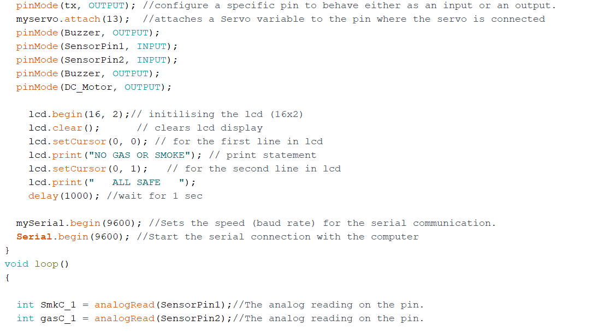

Slide 31
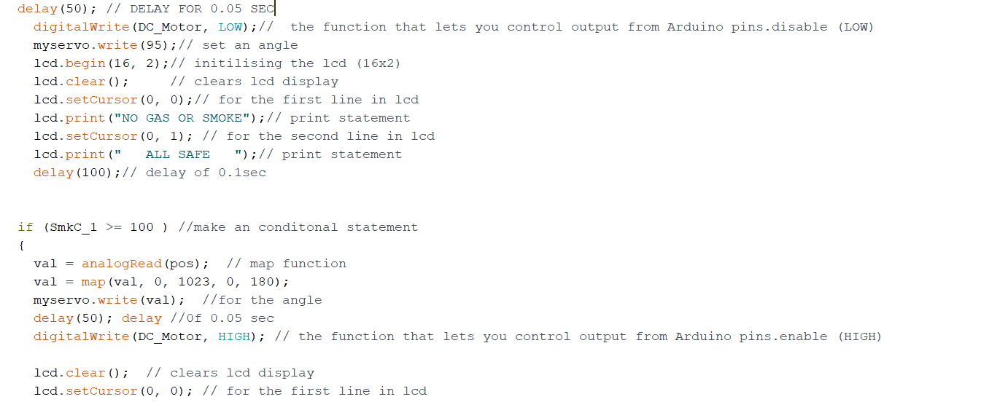

Slide 32
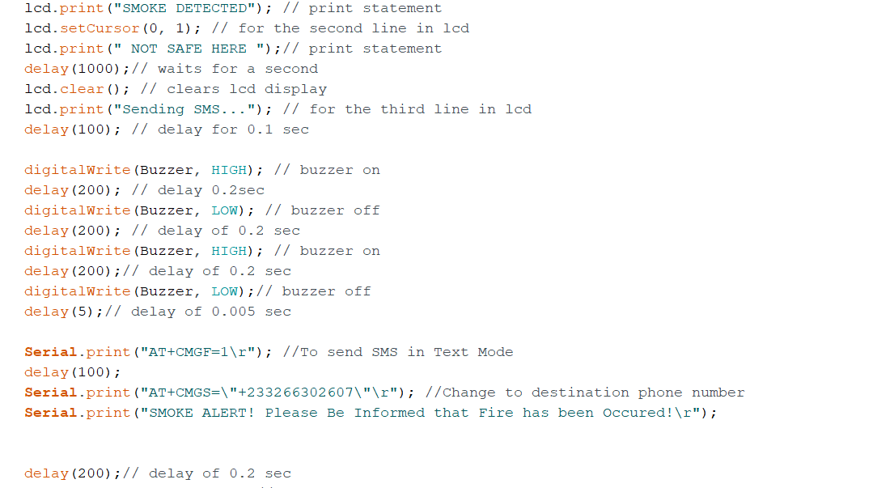

Slide 33
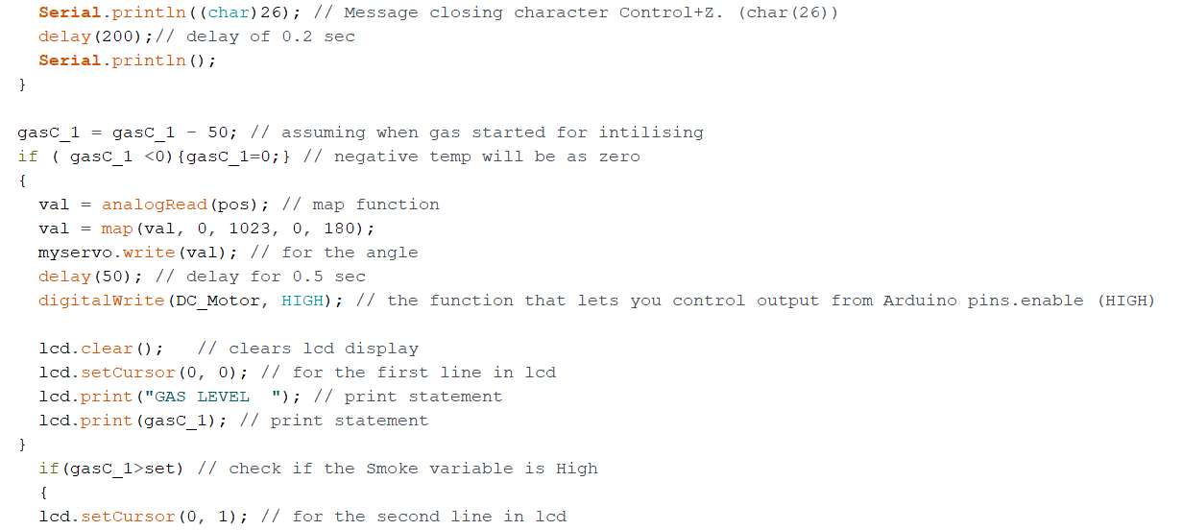

Slide 34
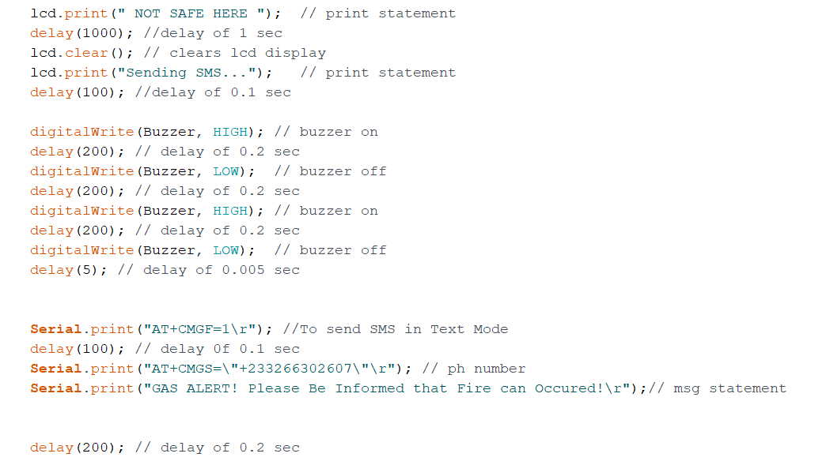

Slide 35


Slide 36
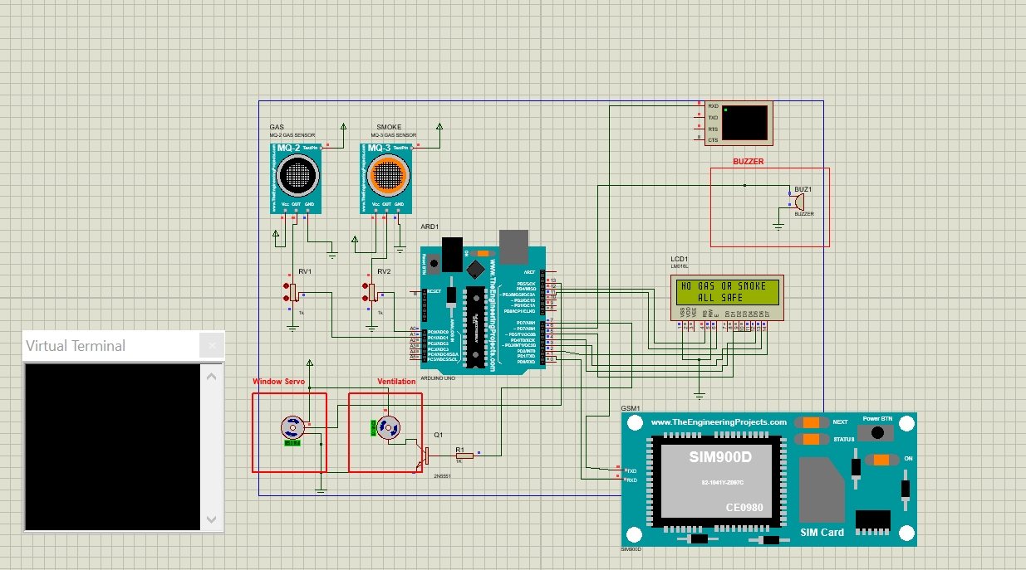
Result’s
No smoke or gas detected

Slide 37
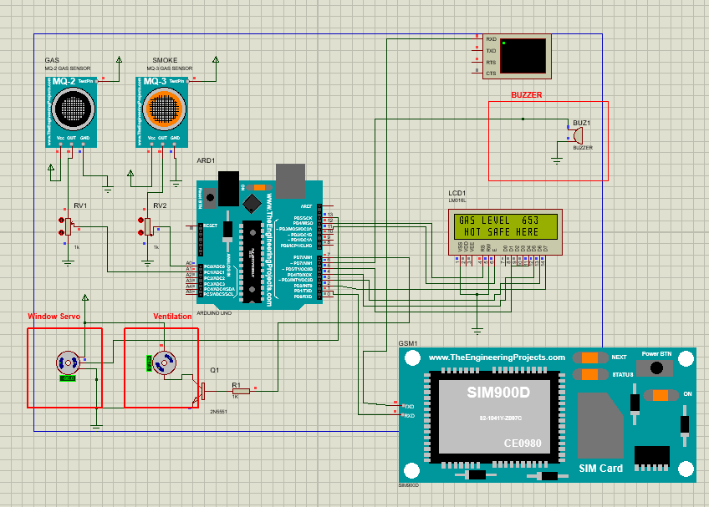
GAS LEVEL DETECTED SHOWN IN LCD

Slide 38
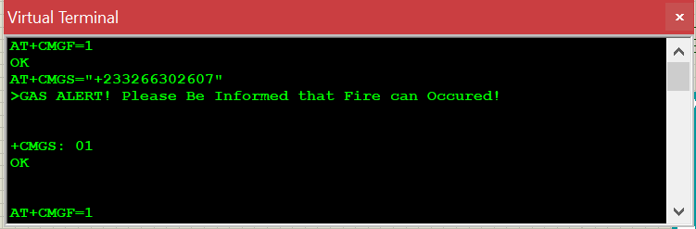
SMS SENT BY GSM MODULE TO USER
GAS ALERT PLEASE BE INFORMED THAT FIRE CAN OCCURED

Slide 39
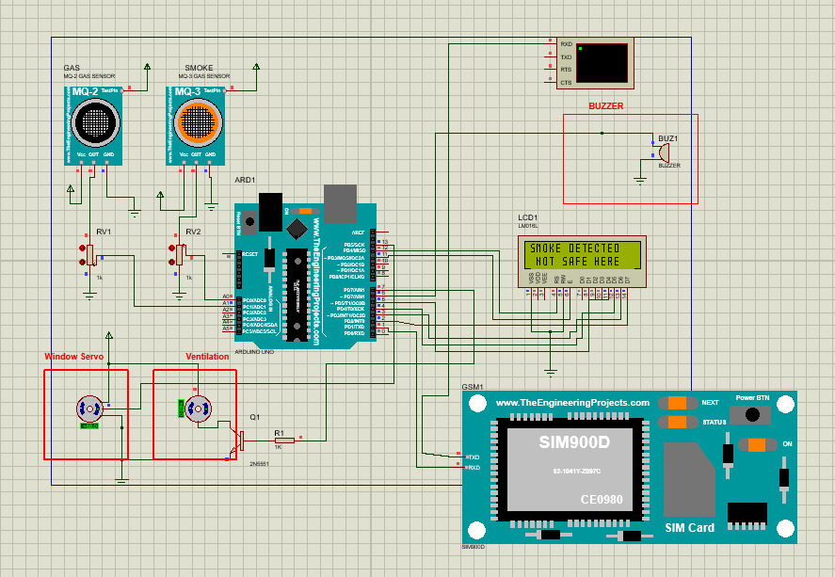
SMOKE DETECTED DISPLAYED IN LCD DISPLAY

Slide 40
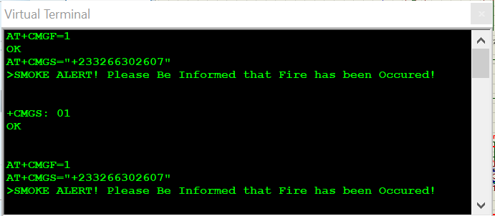
SMS SENT BY GSM MODULE TO USER THAT
SMOKE ALERT PLEASE BE INFORMED THAT FIRE HAS BEEN OCCURED

Slide 41
05
Conclusion
The design and construction of a GSM based Gas and Smoke detection and prevention system was successfully carried out and tested effectively.
we successfully demonstrated when gas or smoke occurs the sensors detects and sends an message by gsm module and we can see the message in the screen.

Slide 42





THANK YOU
1807258 | Ashish
1807259 | Ashutosh Yadav
1807265 | B.Dheeraj Chandan
1807266 | Biswayan Banerjee
1807292 | P. Sai Manohar

